Slide 1
Development of a Diagonal Isometric Tensor Network Algorithm
Masters thesis
Benjamin Sappler

Slide 2
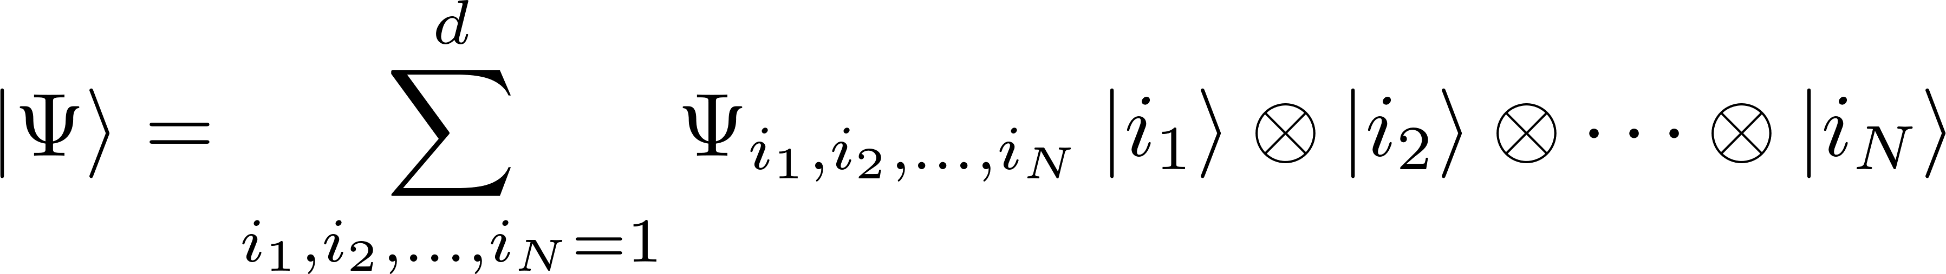
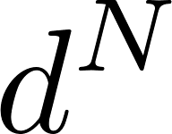
Simulation of QMB systems
parameters
Approximations are needed!

Slide 3
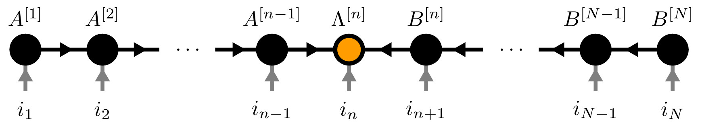
Contents
Matrix Product States (MPS)
Isometric Tensor Product States (isoTPS)
YB-isoTPS

Slide 4
Contents
Matrix Product States (MPS)
Isometric Tensor Product States (isoTPS)
YB-isoTPS

Slide 5

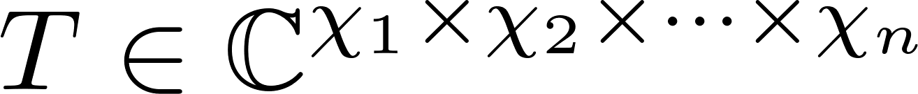
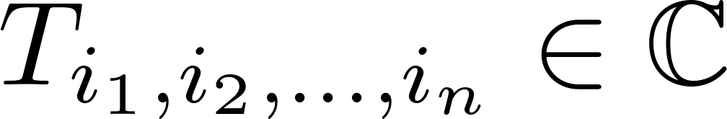
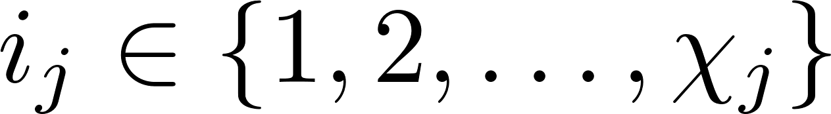
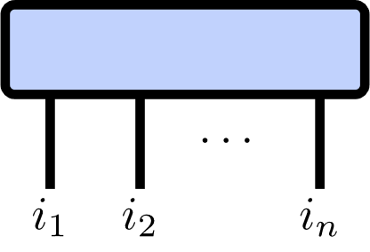
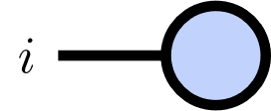
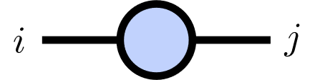
Tensor Networks
Tensor of rank :

Slide 6
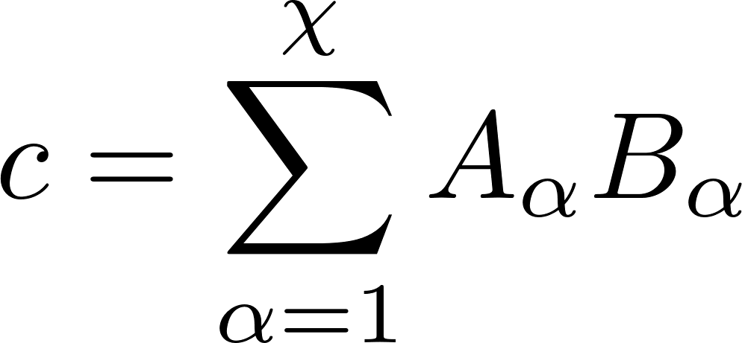
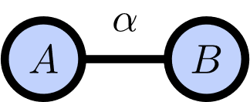
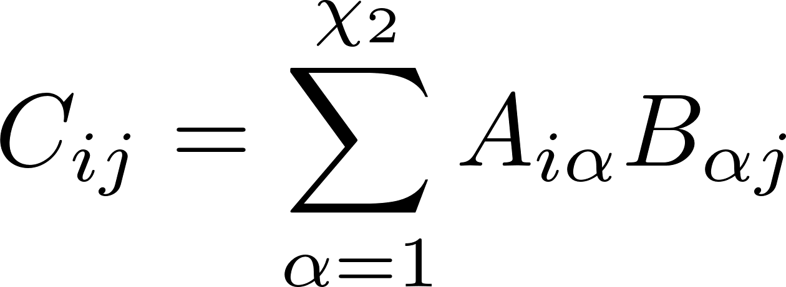
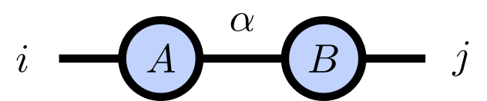
Index Contractions

Slide 7
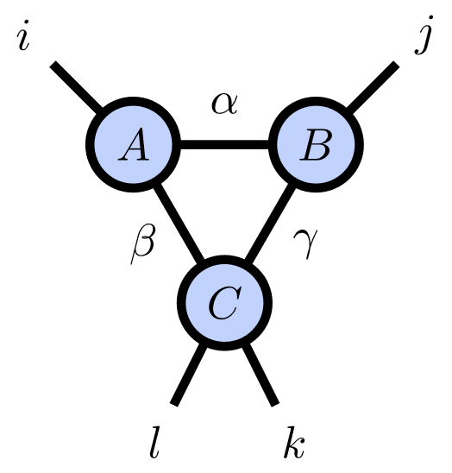
Index Contractions

Slide 8
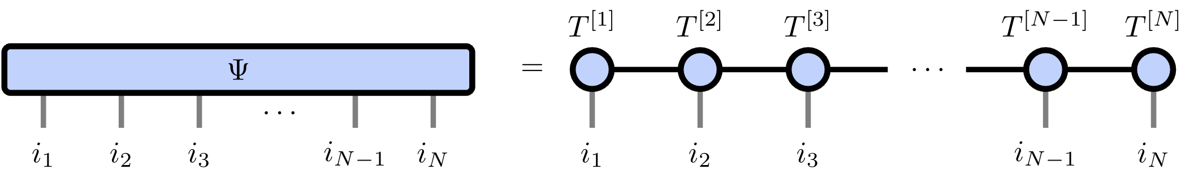
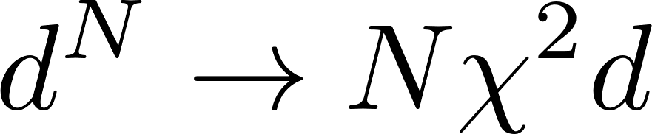
Matrix Product States
Number of parameters:

Slide 9
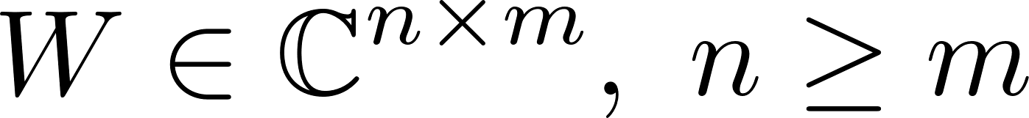
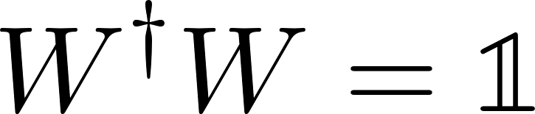
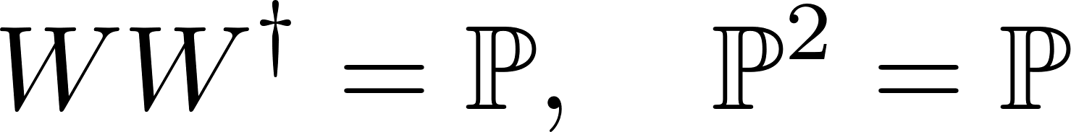
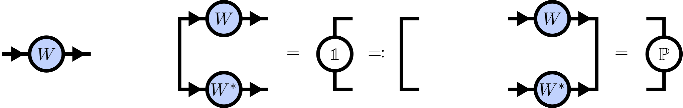
Isometries

Slide 10
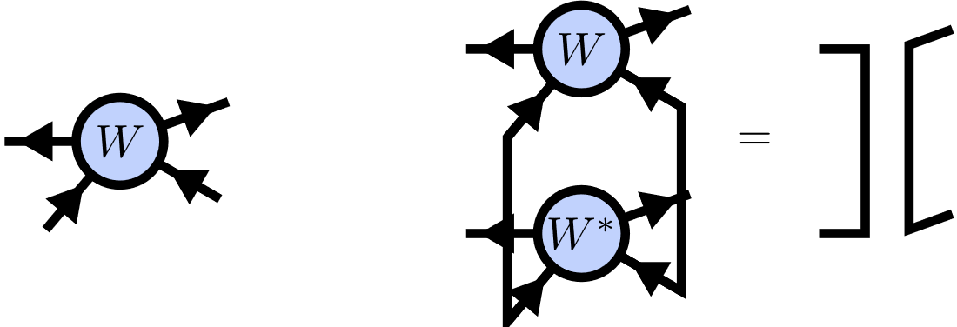
Isometric Tensors

Slide 11
Canonical Form
TODO: Left/right isometry condition

Slide 12
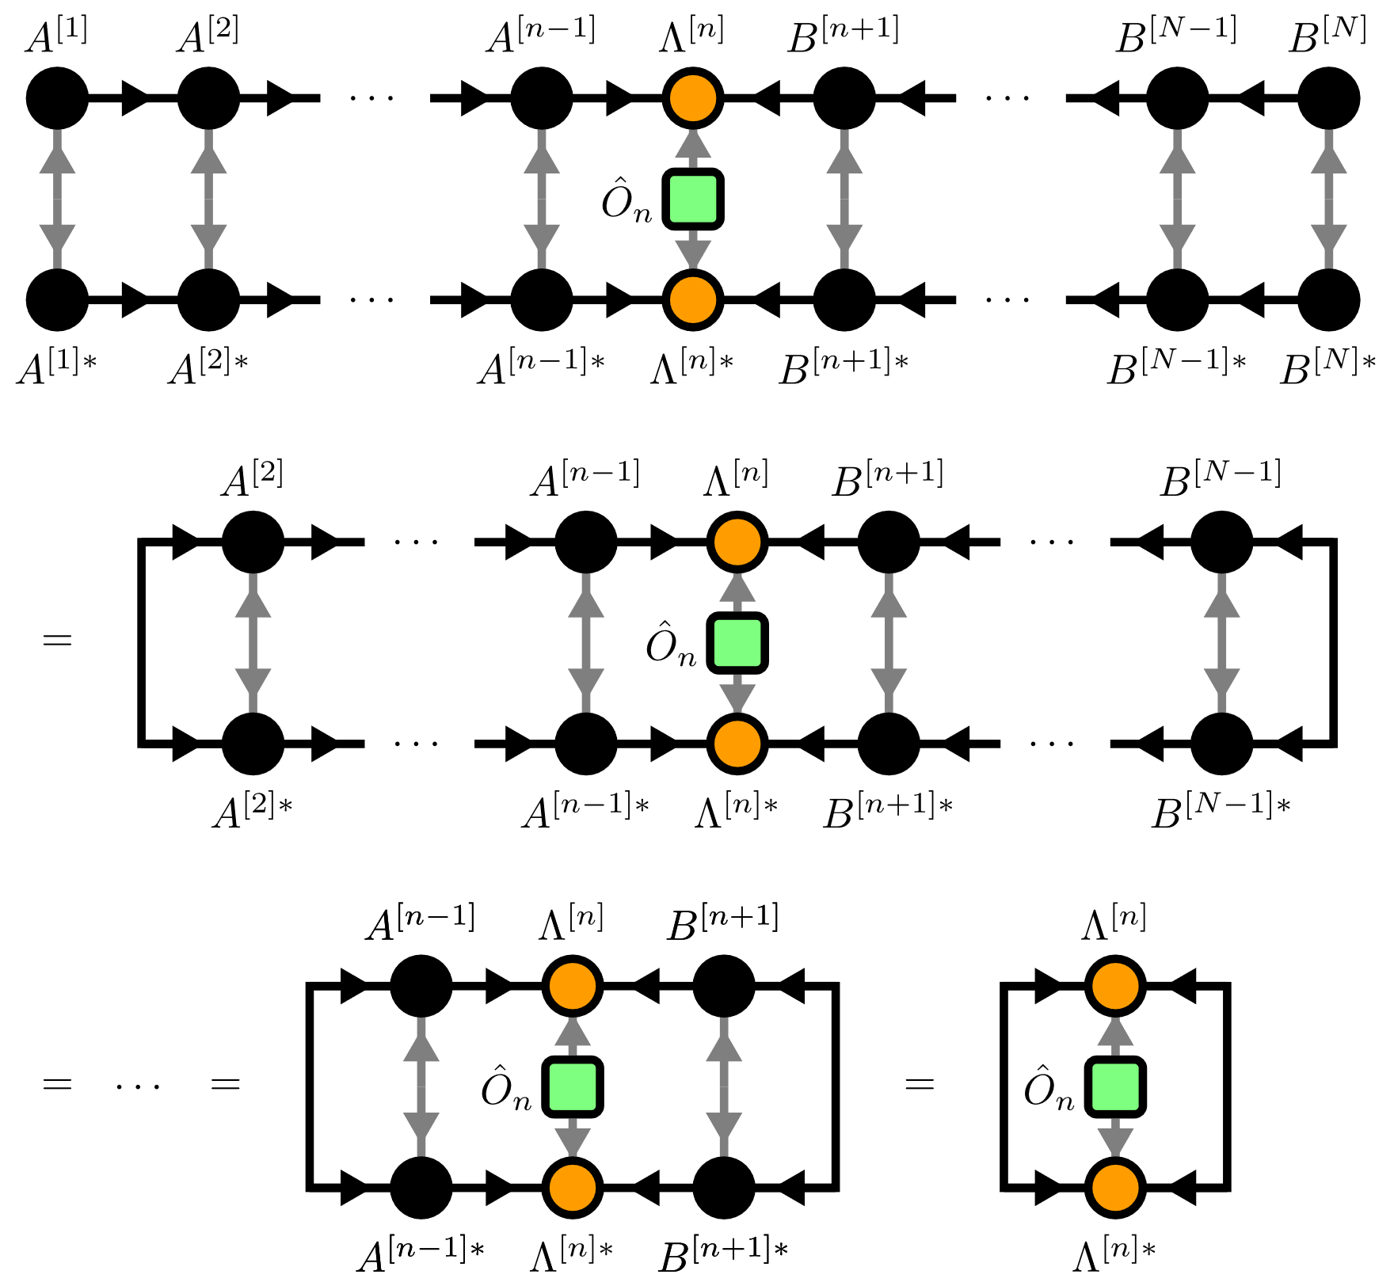
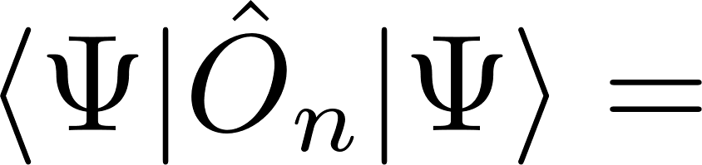
Local Expectation Values

Slide 13
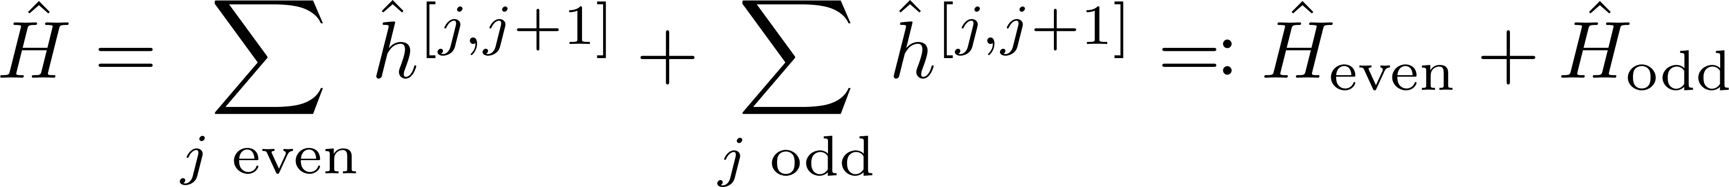
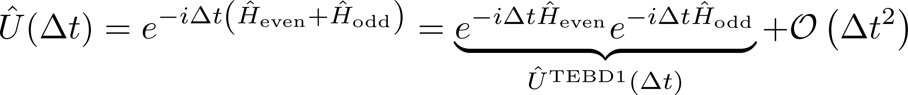
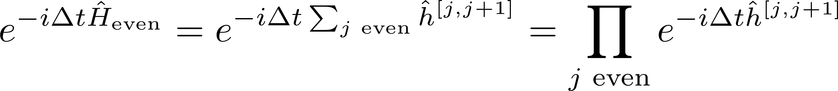
Time evolution

Slide 14
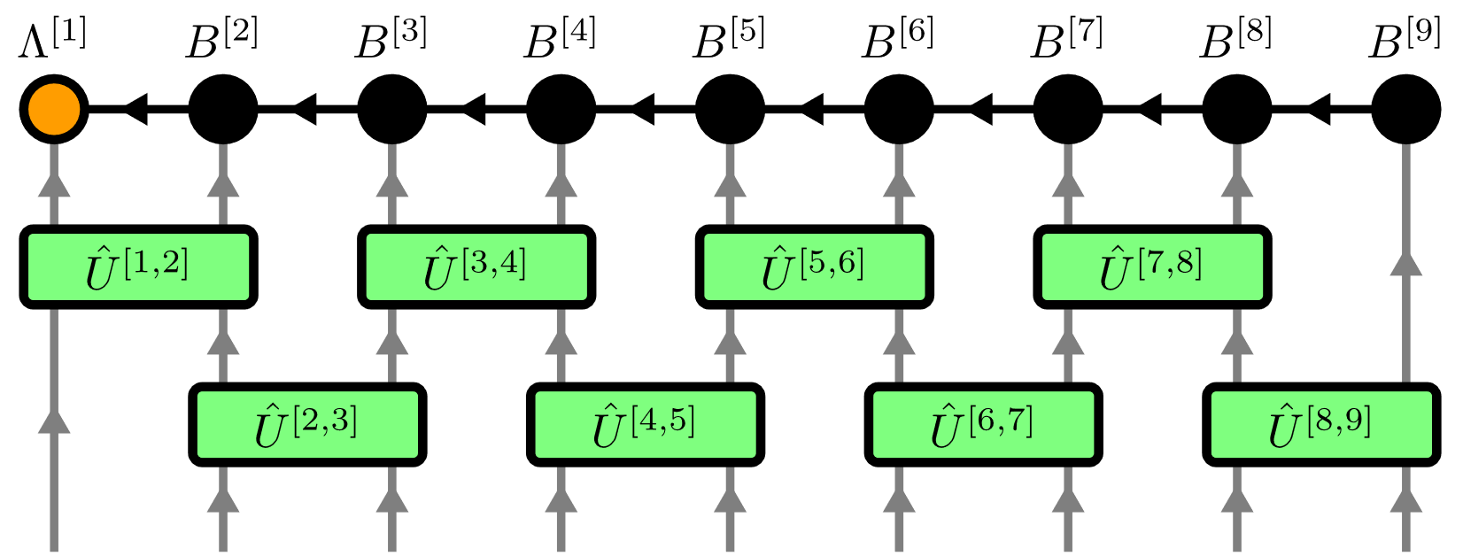
Time Evolving Block Decimation (TEBD)

Slide 15
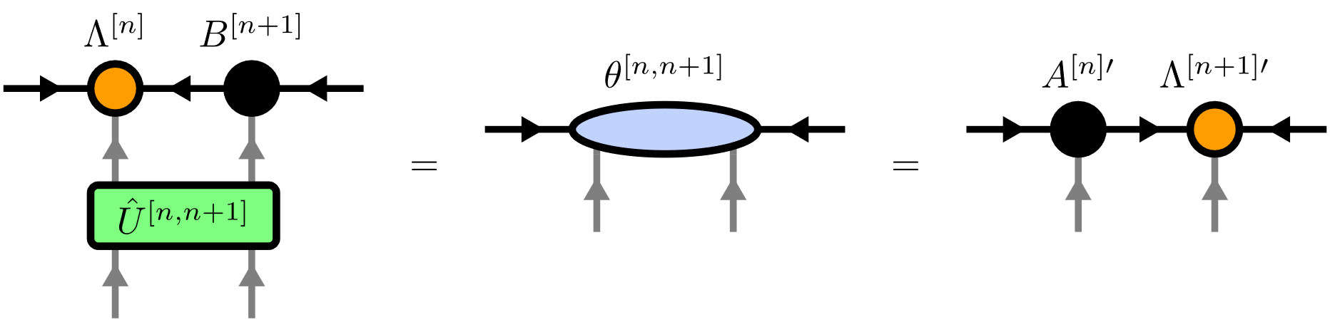
Time Evolving Block Decimation (TEBD)

Slide 16
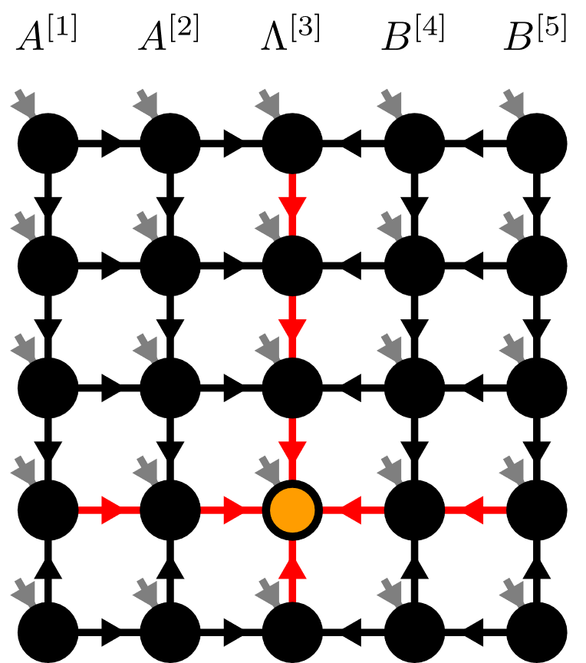
Contents
Matrix Product States (MPS)
Isometric Tensor Product States (isoTPS)
YB-isoTPS

Slide 17
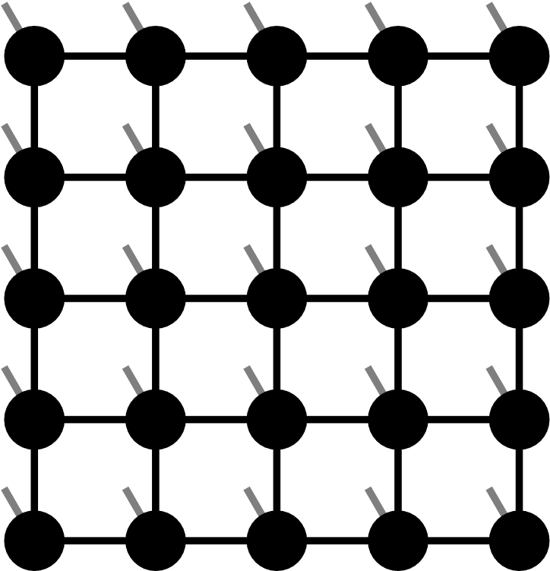
Projected Entangled Pair States (PEPS)

Slide 18
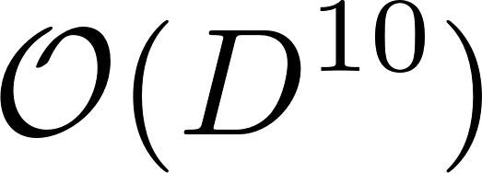
Projected Entangled Pair States (PEPS)
TEBD:

Slide 19
Isometric Tensor Product State

Slide 20
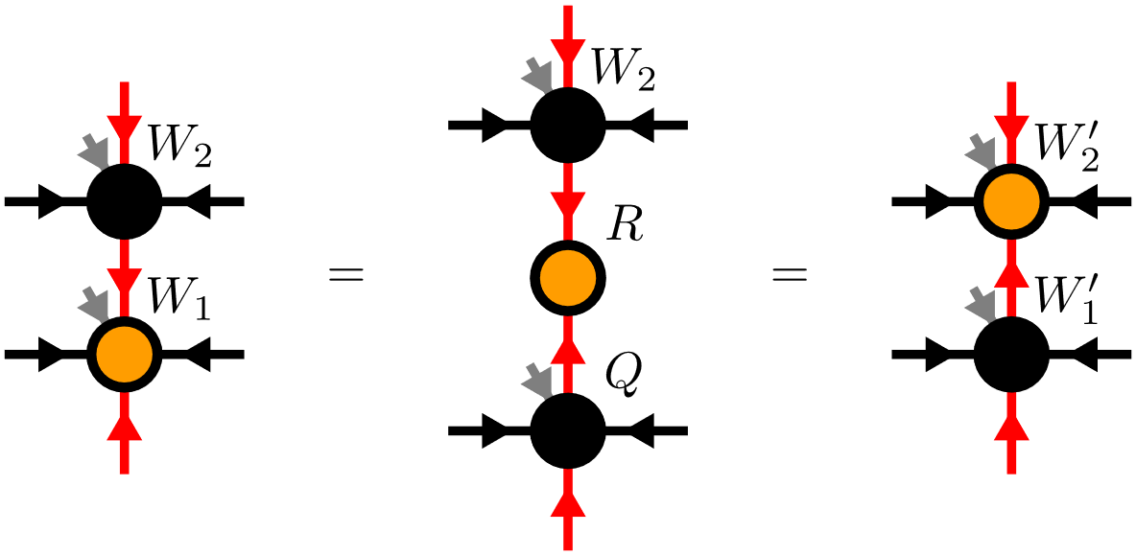
Moving the Orthogonality Center

Slide 21
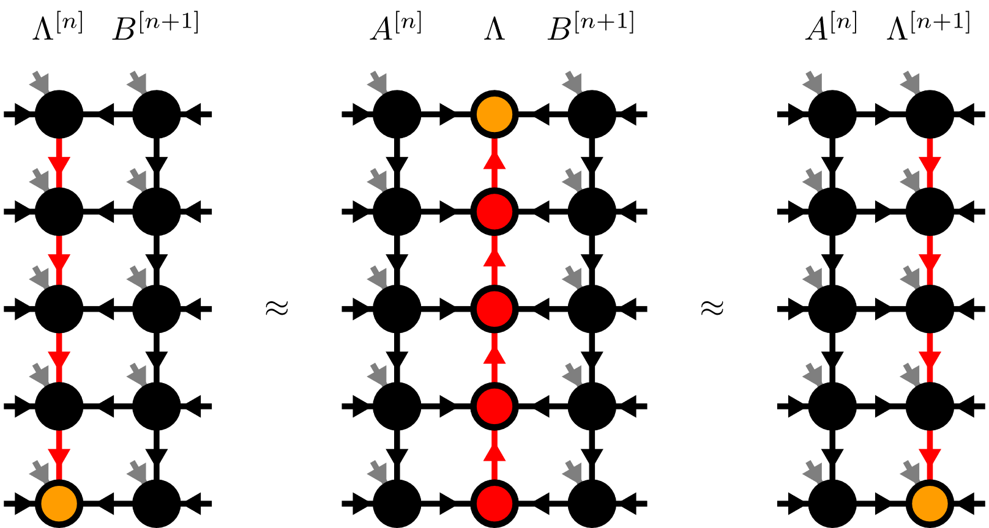
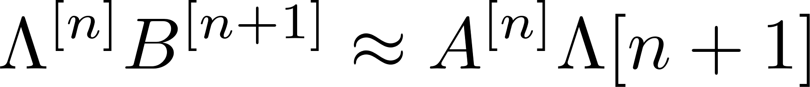
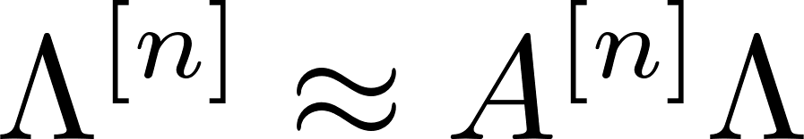

Moving the Orthogonality Hypersurface

Slide 22
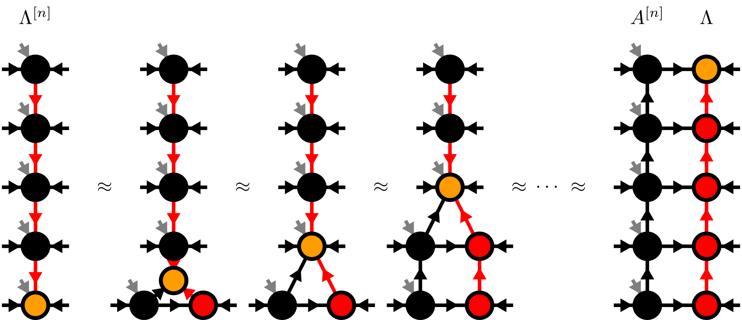
Moses-Move (MM)

Slide 23
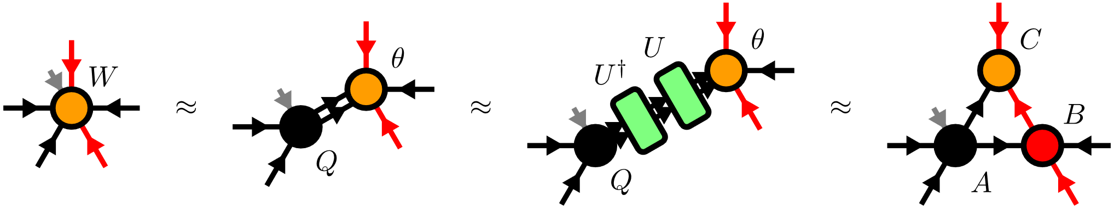
Moses-Move (MM) – Tripartite Decomposition

Slide 24
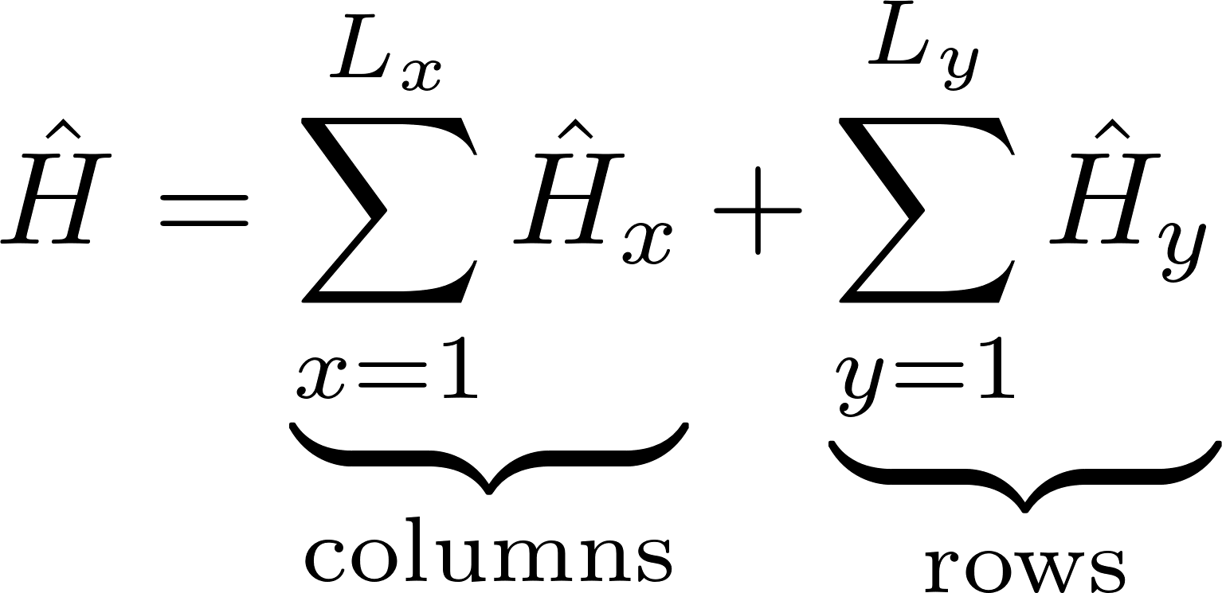
TEBD

Slide 25
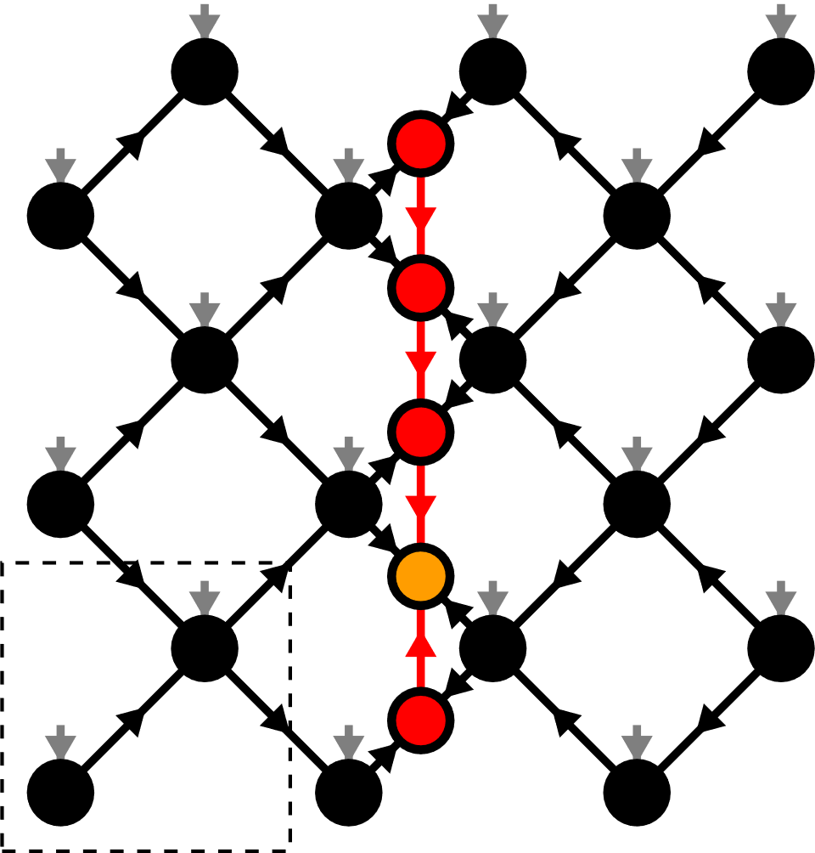
Contents
Matrix Product States (MPS)
Isometric Tensor Product States (isoTPS)
YB-isoTPS

Slide 26
YB-isoTPS

Slide 27
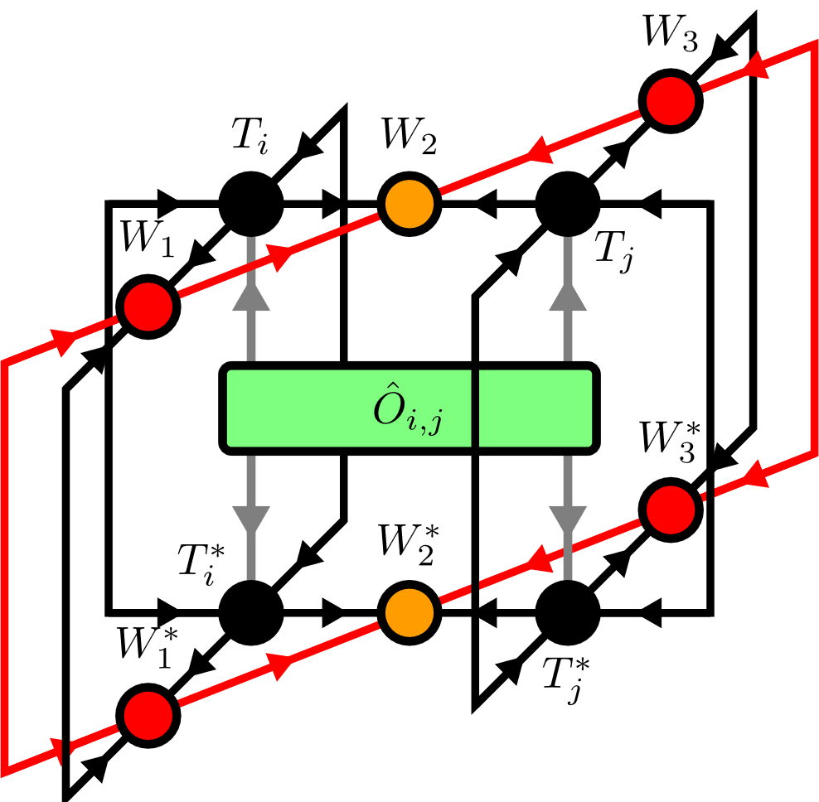
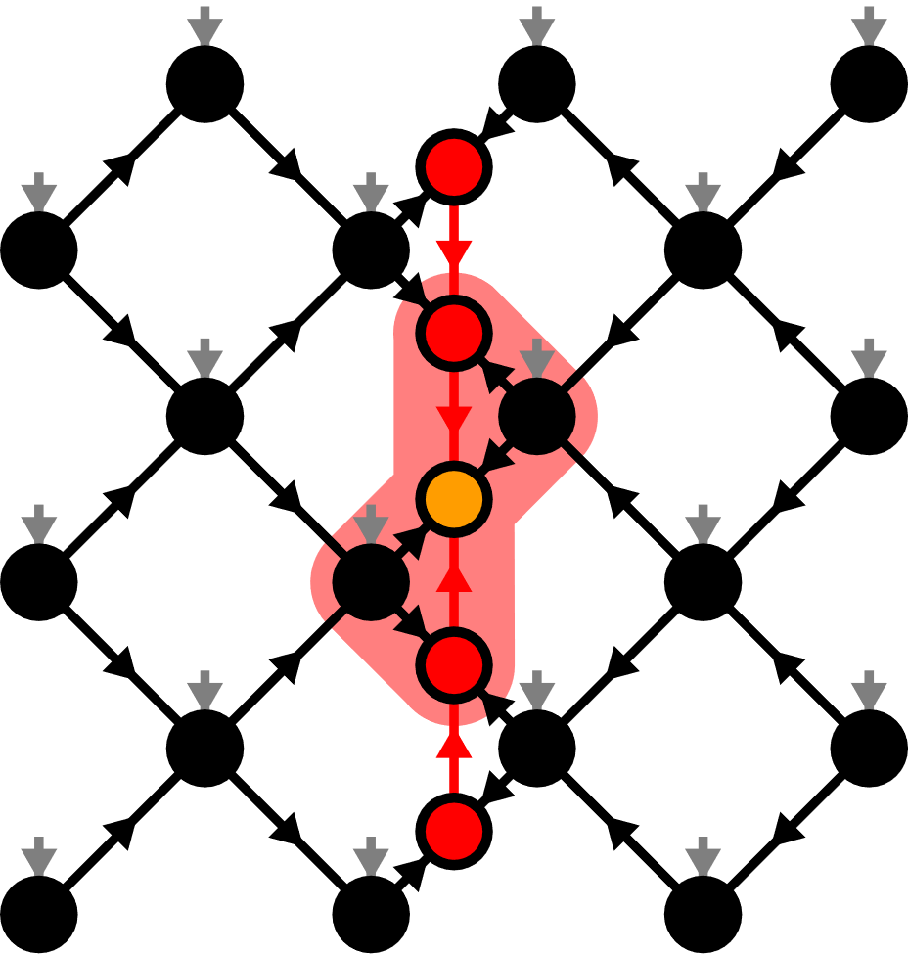
Local Expectation Values

Slide 28
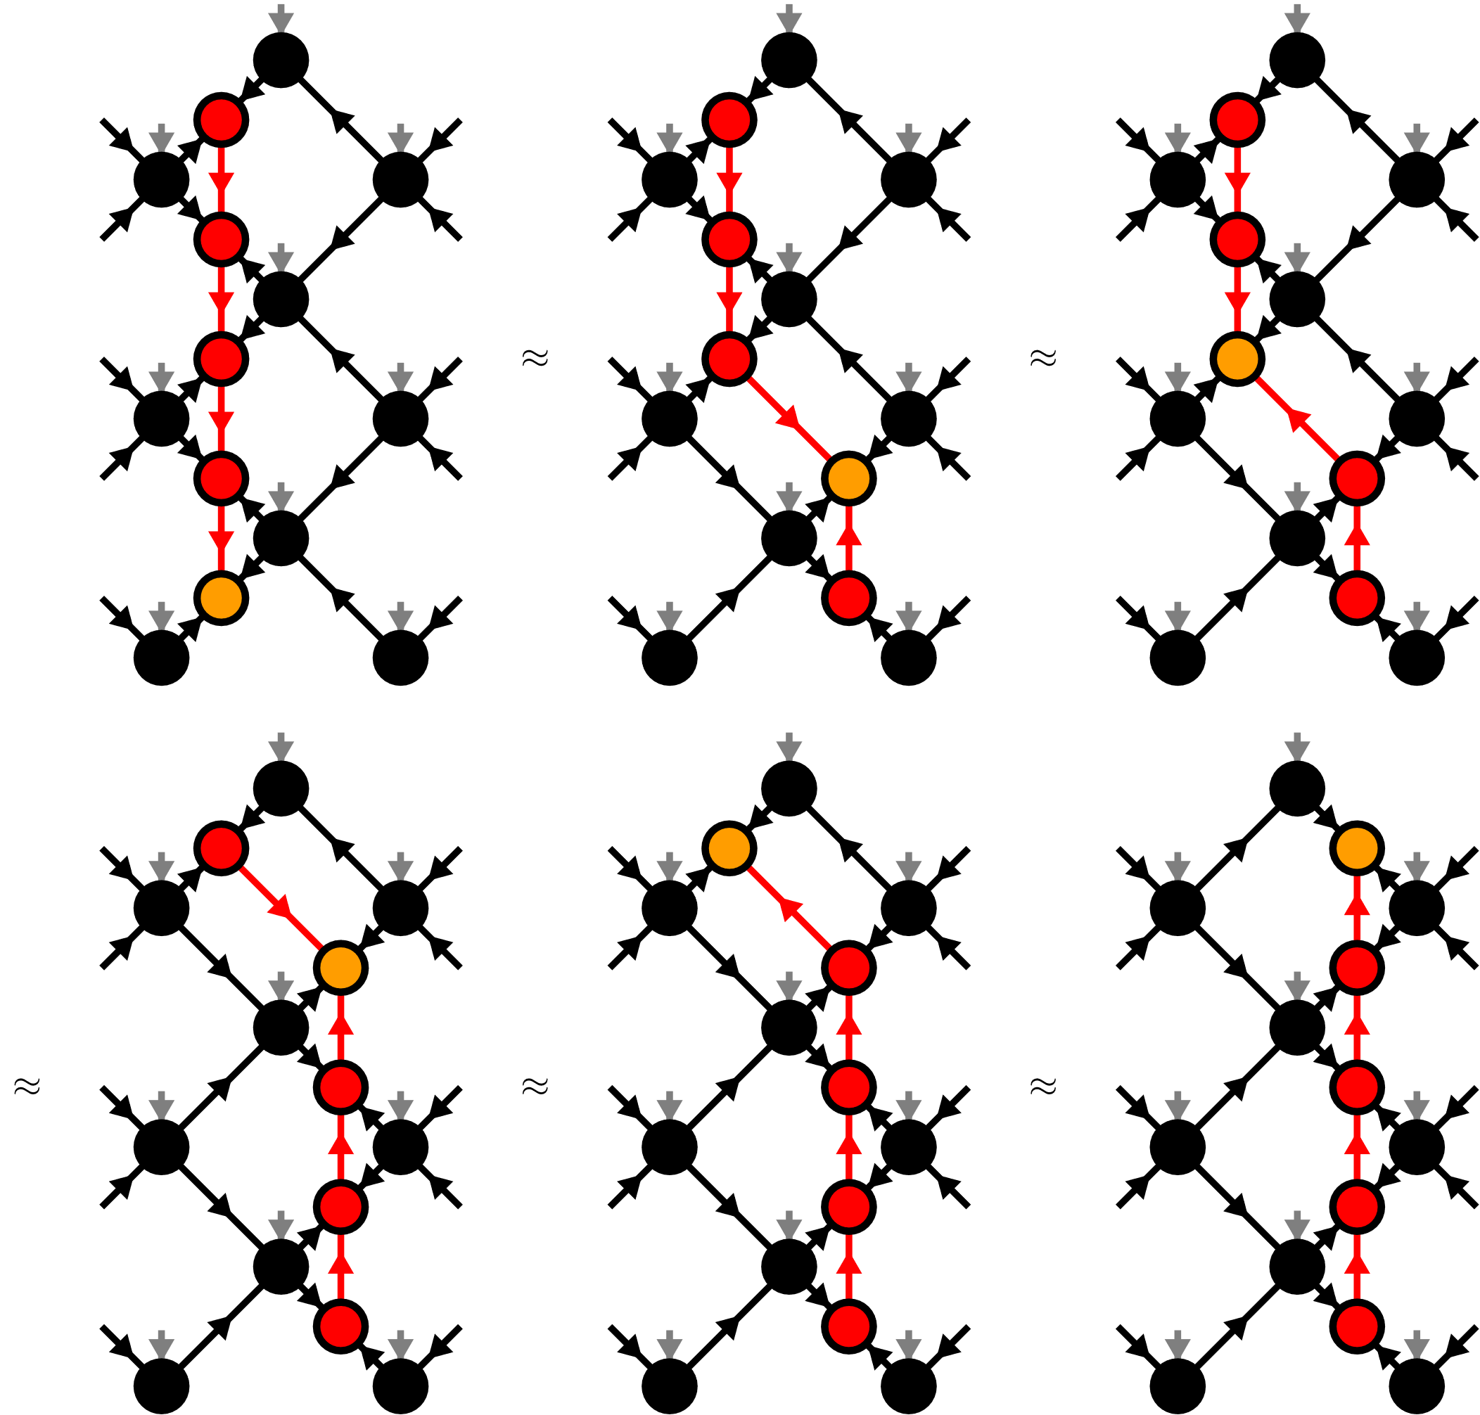
Moving the orthogonality hypersurface

Slide 29
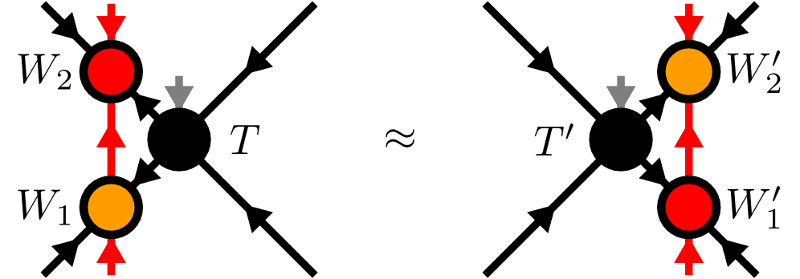
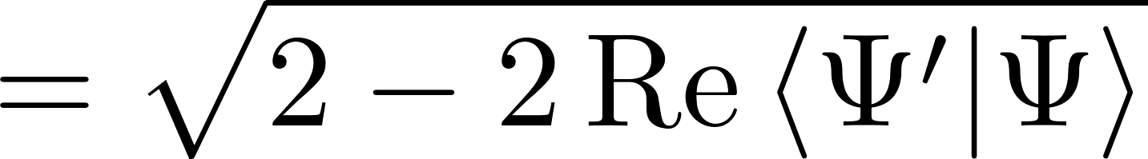
Yang-Baxter (YB) Move
YB Error

Slide 30
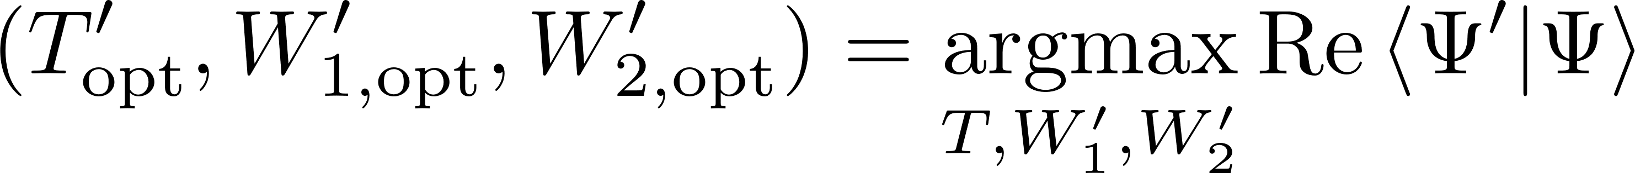
Yang-Baxter (YB) Move
Constrained optimization problem
Two algorithms:
Variational optimization with local updates
Tripartite decomposition using SVD + disentangling

Slide 31
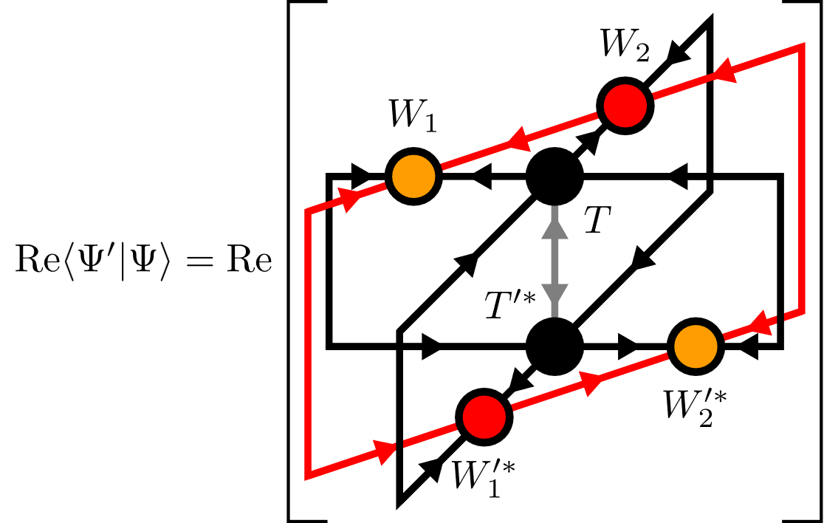
YB-move: Variational optimization

Slide 32
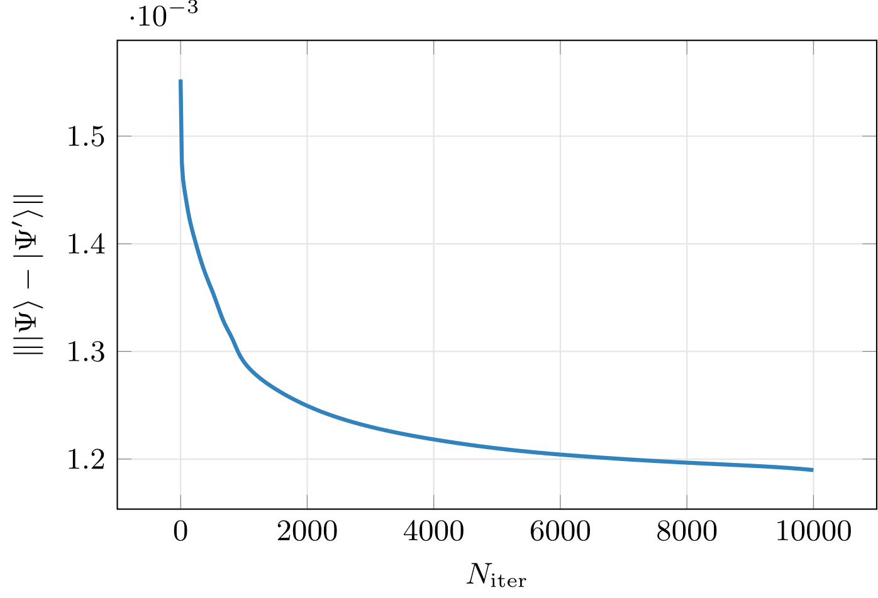
YB-move: Variational optimization

Slide 33
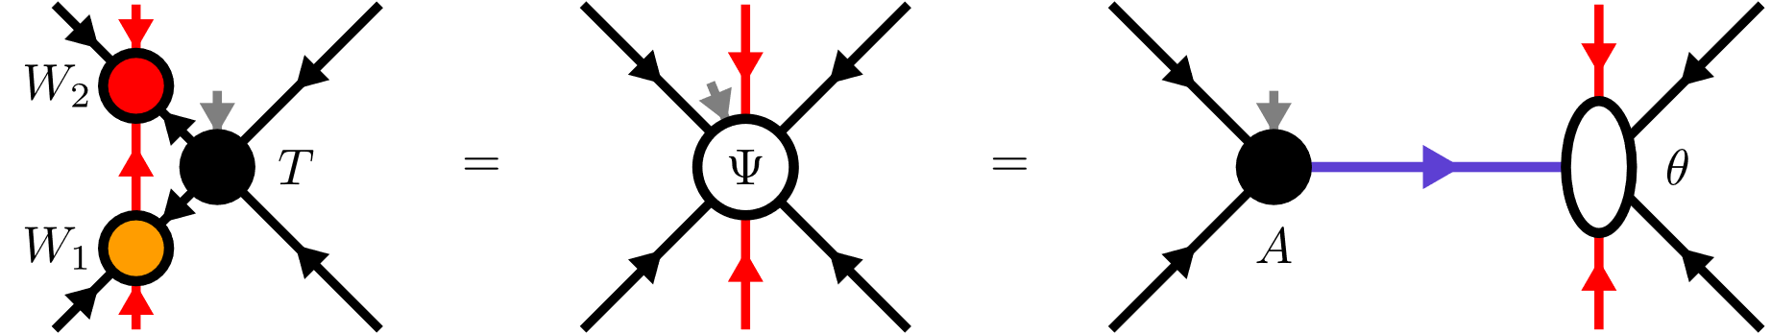
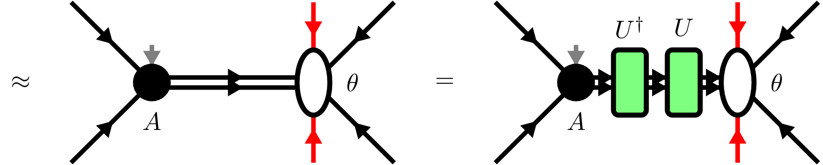
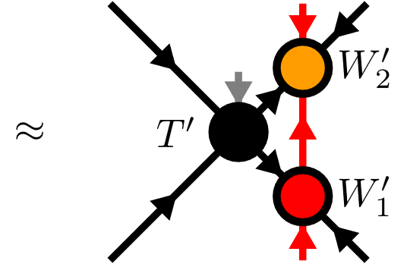
YB-move: Tripartite decomposition

Slide 34

Disentangling procedure

Slide 35



Disentangling procedure
Cost functions:
Truncation error
Renyi-entropy
with

Slide 36




Renyi-2 disentangling
maximize

Slide 37

Renyi-2 disentangling

Slide 38

Riemannian optimization
No easy tensor network form for cost functions
Use Riemannian optimization!

Slide 39



Riemannian optimization
CG:
TRM:

Slide 40

Approximate Gradients

Slide 41


Approximate Gradients
Gradients
CG/TRM

Slide 42

YB-move: Comparison

Slide 43


TEBD: Local updates
Apply local bond operator:
Maximization problem

Slide 44

TEBD: Local updates

Slide 45

TEBD1

Slide 46

TEBD2

Slide 47


Transverse Field Ising (TFI) model
Critical field

Slide 48



Comparing YB-move algorithms

Slide 49


Comparing YB-move algorithms

Slide 50


Comparing YB-move algorithms

Slide 51

Comparing YB-move algorithms

Slide 52


TEBD1 vs TEBD2

Slide 53




Larger lattices

Slide 54

Larger lattices

Slide 55

Real-time evolution: Global quench

Slide 56
Summary & Outlook
TODO
New canonical form
YB move scales worse than MM
Nevertheless YB-isoTPS are cool
Easy generalization: show Honeycomb
Outlook: DMRG, GPU, etc

